Slide 1
OrangeFlare
Auburn Hack-a-thon 2019

Slide 2
The Idea
An all-in-one disaster aid tool. We came up with three features we wanted to implement:
getting users a quick guide to routes to a safe location
keeping them updated with local events
providing a location tool for finding survivors who are lost or trapped

Slide 3
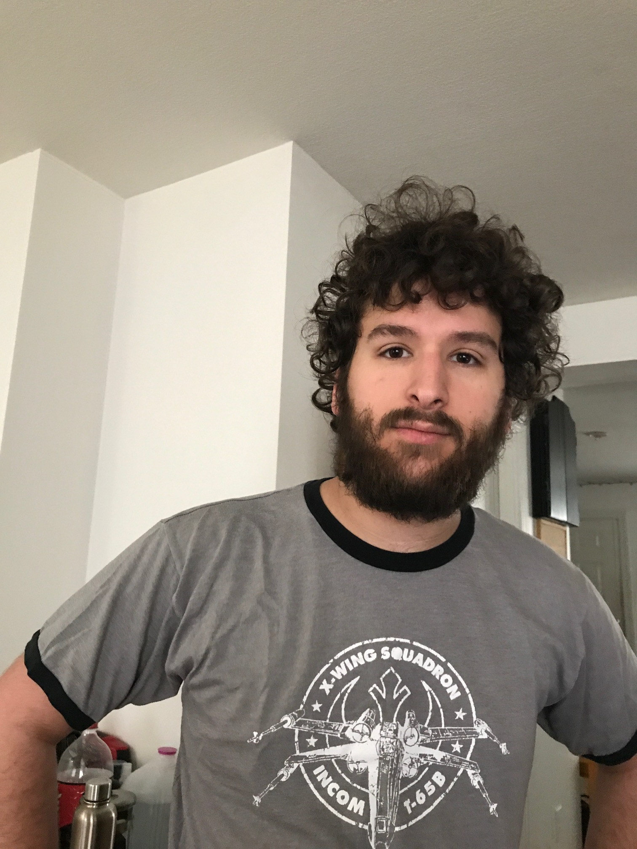
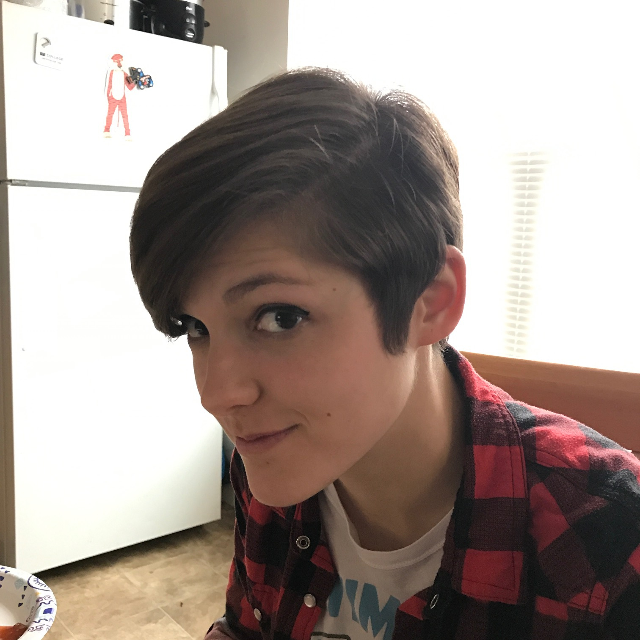
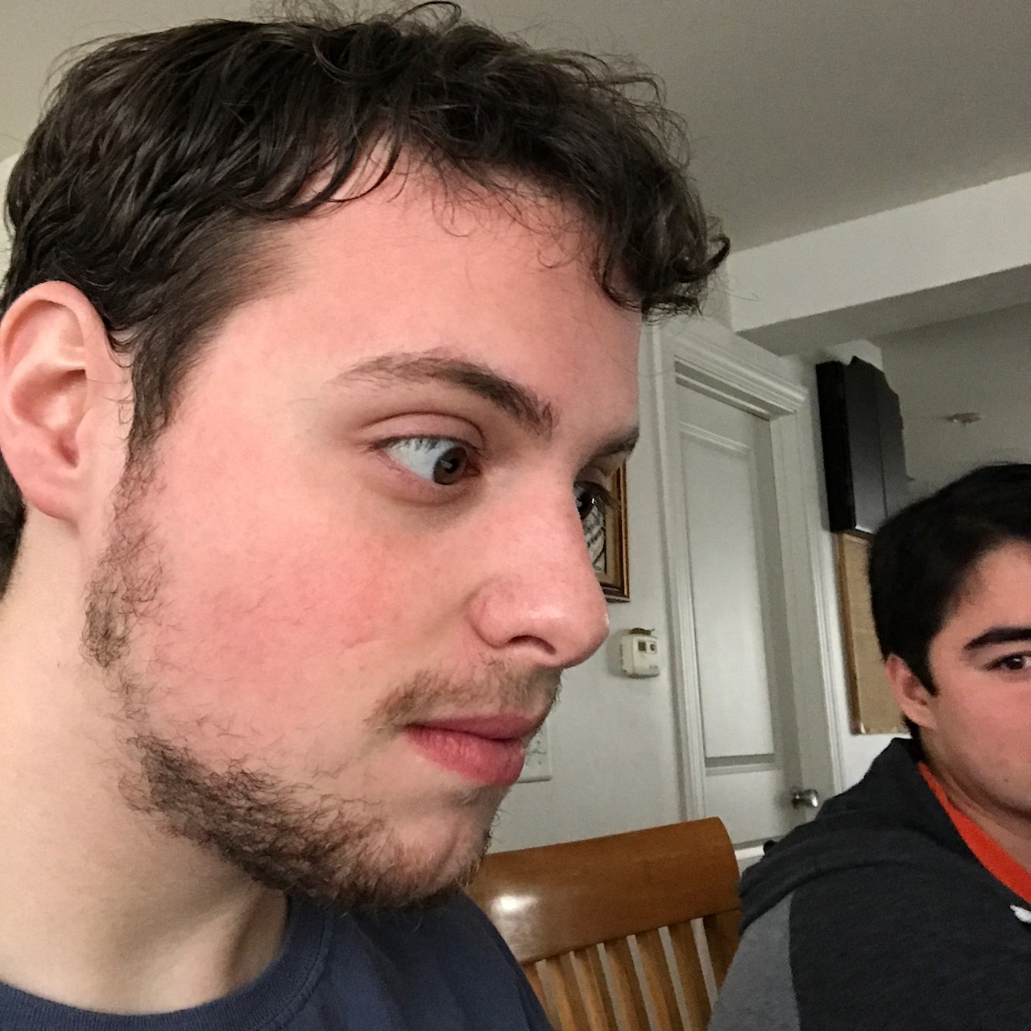
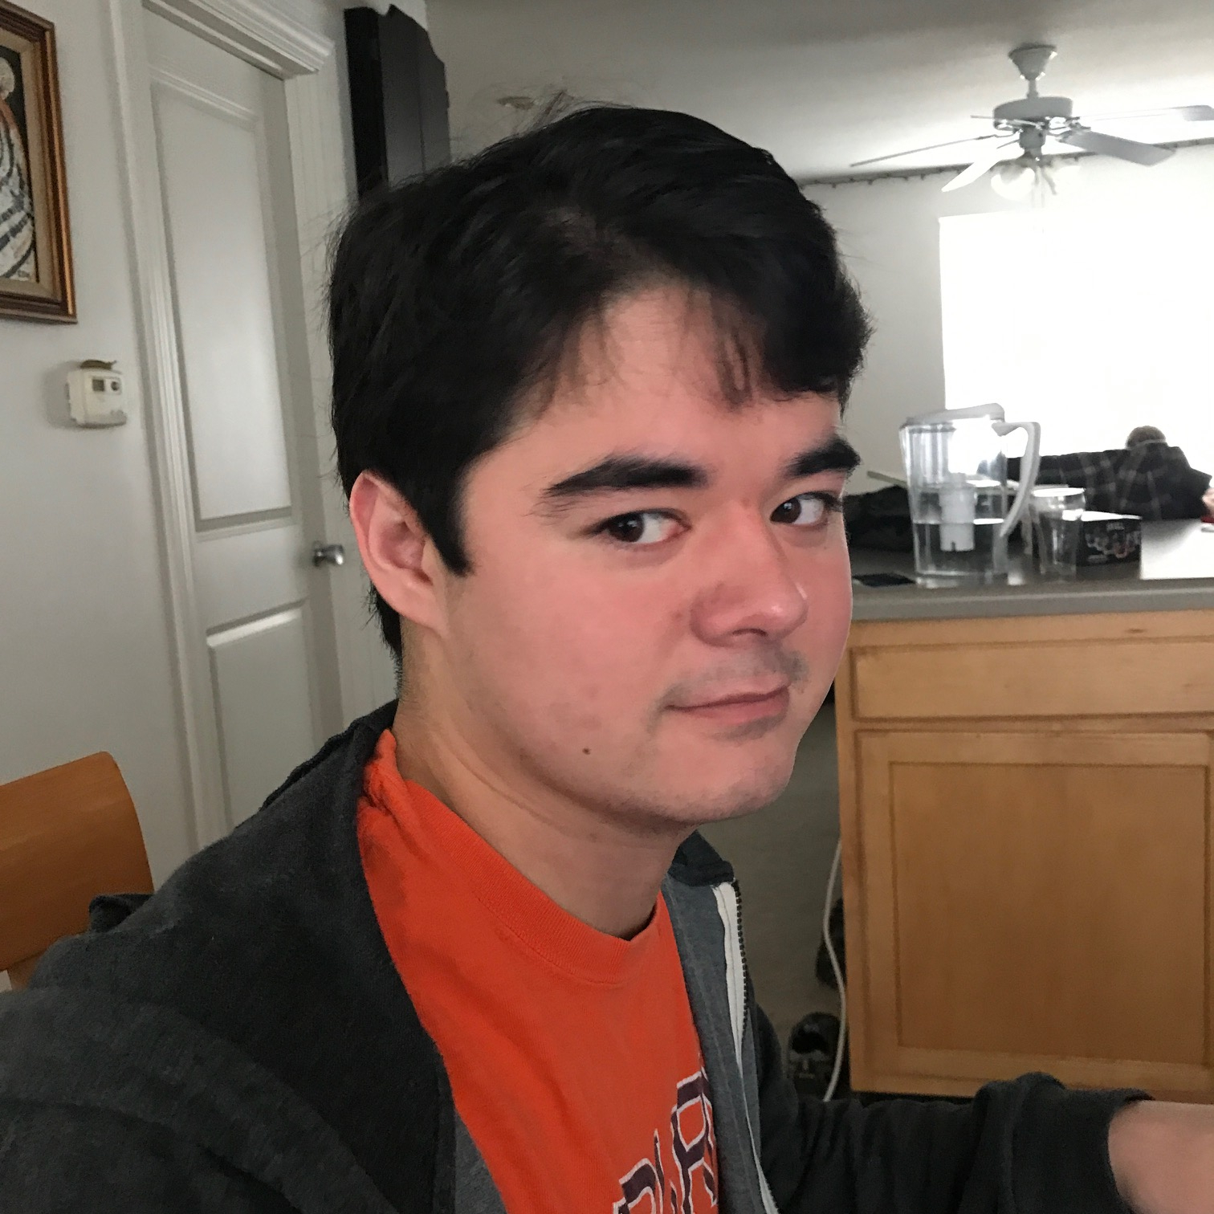
The Team (AKA Morbituaries)
Front-End
Backend
Front-End
Backend
Michael
(Deceased)
Cait
(Deceased Inside)
Alec
(Status Unknown)
Thatcher
(Super Deceased)

Slide 4
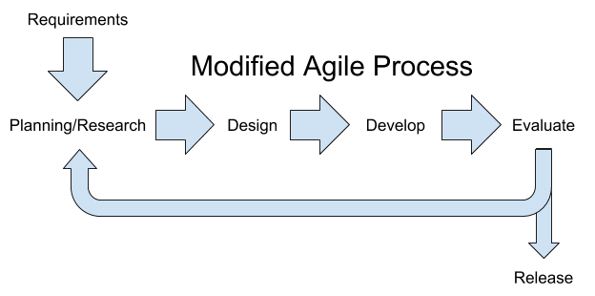
The Process

Slide 5
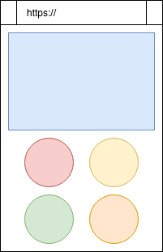
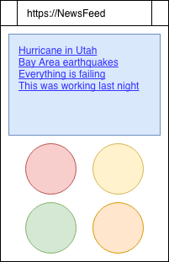
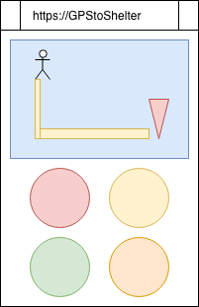
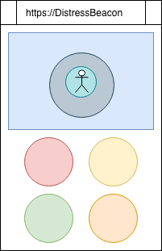
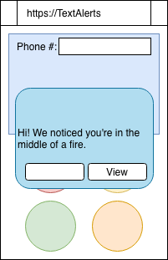
Concept Arts

Slide 6
The Tools
Node.js - General functionality
Twilio - Text message push notifications
GoogleNews API - Local news feed streaming
GoogleMaps API - GPS data
Github/Discord - Collaboration
Some other attempts/Not fully implemented…
React JS Libraries (APIs)
Web-Bluetooth Experimental API (BT location)
Push Notifications (Twilio)
General information display (HTML/CSS issues)

Slide 7
What Went Wrong...
Bluetooth:
Python libraries, Experimental web-bluetooth; not well documented, couldn’t implement any cross-platform .
Implementation issues
Many features proved difficult to integrate and required work arounds due to time constraints
General “Not enough time.”
Much of the implementation issues we are fixable given enough time but we were unable to resolve all issues.

Slide 8
What Went Right!
GoogleMaps & GoogleNews APIs functions as they are supposed to
Web-Mobile functionality
Despite everything not being entirely implemented, we were able to provide proof of concepts: for the functionality of our features

Slide 9
Where We Would Go
Bluetooth local locator:
experimental web-bluetooth API
Allow first responders to locate survivors potentially trapped under rubble.
Difficulty interpreting resources, opted for geolocation.
Would be excellent feature to implement as it would give extra tools in rescue efforts
More powerful frameworks:
Would have made the project more sustainable
Better access to more powerful APIs

